Slide 1
GRAMMARS
UNIT II
Simplification of CFG

Slide 2
Simplification of CFG
Simplified CFG - convert any CFG G into an equivalent CFG that has no useless symbols and ϵ-productions or unit productions.
To study the properties of context-free grammars and languages.
To represent any grammar in a special form known as its normal form.
Chomsky Normal Form (CNF)
Greibach Normal Form (GNF)
Simplify a grammar by
Eliminating all ϵ-productions;
Eliminating all unit productions;
Eliminating all the useless symbols

Slide 3
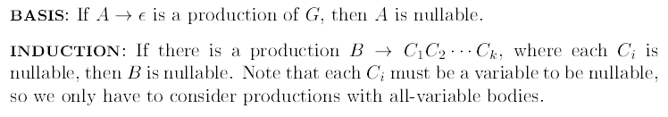
Eliminating ϵ-productions
A CFG G can be simplified by eliminating all the ϵ-productions in it. Of course, then we will not be able to derive ϵ, if ϵ ∈ L(G).
First identify the nullable variables — a variable A is nullable if
Iterative Algorithm to find nullable symbols of Grammar G

Slide 4
Eliminating ϵ-productions
When a variable A is nullable, and A appears in the body of a production B → CAD, then that production can be replaced by two productions, one in which A is retained, and the other in which A is removed.
Now, all the ϵ-productions can be removed from the set of productions.

Slide 5
Eliminating ϵ-productions
Example: Consider the following CFG G:
S → AB
A → aAA | ϵ
B → bBB | ϵ
A and B are directly nullable because of the productions A → ϵ and B → ϵ. We can drop both these null productions. Since both A and B are nullable and we have the production S → AB, the variable S is also nullable.
S → AB is replaced by four possible combinations S → AB | A | B | ϵ, and we drop the ϵ-production S → ϵ.
A → aAA is replaced by A → aAA | aA | a
B → bBB is replaced by B → bBB | bB | b
Resulting grammar is
S → AB | A | B
A → aAA | aA | a
B → bBB | bB | b
Nullable symbols: S, A, B

Slide 6

Eliminating ϵ-productions
If the grammar G₁ is constructed from G by the above construction for eliminating ϵ productions, then

Slide 7
Eliminating unit productions
A unit production is a production of the form A → B, where both A and B are variables.
Unit production can complicate certain proofs and they also introduce extra steps into derivations that need not be there.
Unit productions can be safely eliminated and normal forms of CFG do not have them.

Slide 8
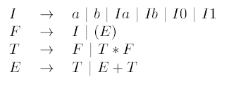
Eliminating unit productions
Example - CFG for simple arithmetic expressions
Here the unit production E → T can be replaced by expanding T. E → F | T ∗ F | E + T
This has introduced a new unit production E → F. Expanding F, E → I | (E) | T ∗ F | E + T.
We can completely eliminate unit productions for E.
E → a | b | Ia | Ib | I0 | I1 | (E) | T ∗ F | E + T

Slide 9
Eliminating unit productions
This technique - expanding unit productions until they disappear - often works. But it can fail if there is a cycle of unit productions such as A → B, B → C, and C → A.
To handle this properly, we first need to find all the unit pairs of variables. A pair of variables (A, B) is said to be a unit pair provided A B using only unit productions.
Determine all the unit pairs in a grammar as follows:
Basis: (A, A) is a unit pair for any variable A.
This is because A A in zero steps.
Induction: Suppose (A, B) is a unit pair and B → C is a unit production, where C is a variable. Then (A, C) is a unit pair.

Slide 10
Eliminating unit productions
Basis: (E, E), (T,T), (F, F), and (I, I) are unit pairs
Induction: Given (E, E) and E → T, gives us the unit pair (E,T).
All the unit pairs can be found: (E, E), (T,T), (F, F), (I, I), (E,T), (E, F), (E, I), (T, F), (T, I), and (F, I).

Slide 11
Eliminating unit productions
Algorithm
Given a CFG G = (V,T, P, S), construct CFG G ′ = (V,T, P ′ , S) as follows:
Find all the unit pairs of G.
For each unit pair (A, B), add to P ′ all the productions A → α, where B → α is a non-unit production in P.
Note that this also covers the case where A = B, and so P ′ retains all the non-unit productions of P.
we create the new set of productions by using the first member of a pair as the head and all the nonunit bodies for the second member of the pair as the production bodies

Slide 12
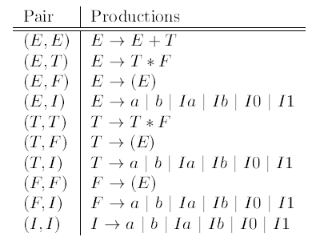
Eliminating unit productions
Considering the pair (E, E), we get the production
E → E + T in P′ .
Considering the pair (E, I), we get the productions
E → a | b | Ia | Ib | I0 | I1.
Find productions corresponding to all the unit pairs.

Slide 13
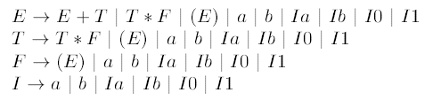
Eliminating unit productions
The resulting grammar is
If the grammar G′ is constructed from G using the above algorithm for eliminating unit productions, then L(G ′ ) = L(G).

Slide 14
Eliminating useless symbols
A symbol X (which can be a terminal or non-terminal) is said to be useful for the grammar G if it is involved in the derivation of a word w ∈ T∗, i.e., if there is some derivation of the form S αXβ w.
A symbol is said to be useless if it is not useful.
Obviously the useless symbols do not contribute to the language of the grammar and hence can be safely removed.
How do we find the useless symbols in a given grammar? For this, we define two more concepts called generating and reachable symbols.
We first remove all the symbols that are not generating and then remove all the symbols that are not reachable.

